Slide 1

Competitive Programming From Problem 2 Solution in O(1)
P
T
H
I
N
K
F
A
S
T
S
The Last words...
Mostafa Saad Ibrahim
PhD Student @ Simon Fraser University

Slide 2
Application types
We can develop several application types
Console Applications
GUI \ Desktop Applications
Web Applications
Mobile Applications
C++ is major in Console applications, but can be used with others too

Slide 3
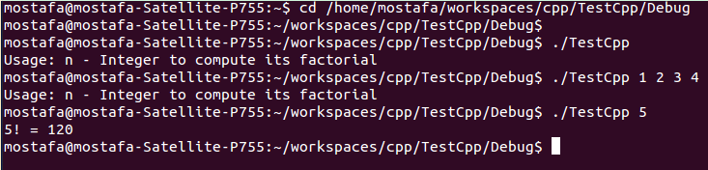
Application Type: Console
What we are doing all the time :)
My opinion: Very good to focus on it during the first 2 years.
Don’t waste your time with the other application types while being young

Slide 4
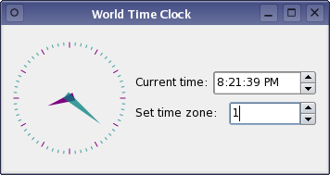
Application Type: Desktop
Nice to learn..but don’t go deep
It is limited in use...only when you need to develop tools to your computer
Think in clock app - Bank app for employee
Notes:
Src: http://doc.qt.io/qt-5/images/worldtimeclockbuilder-example.png

Slide 5
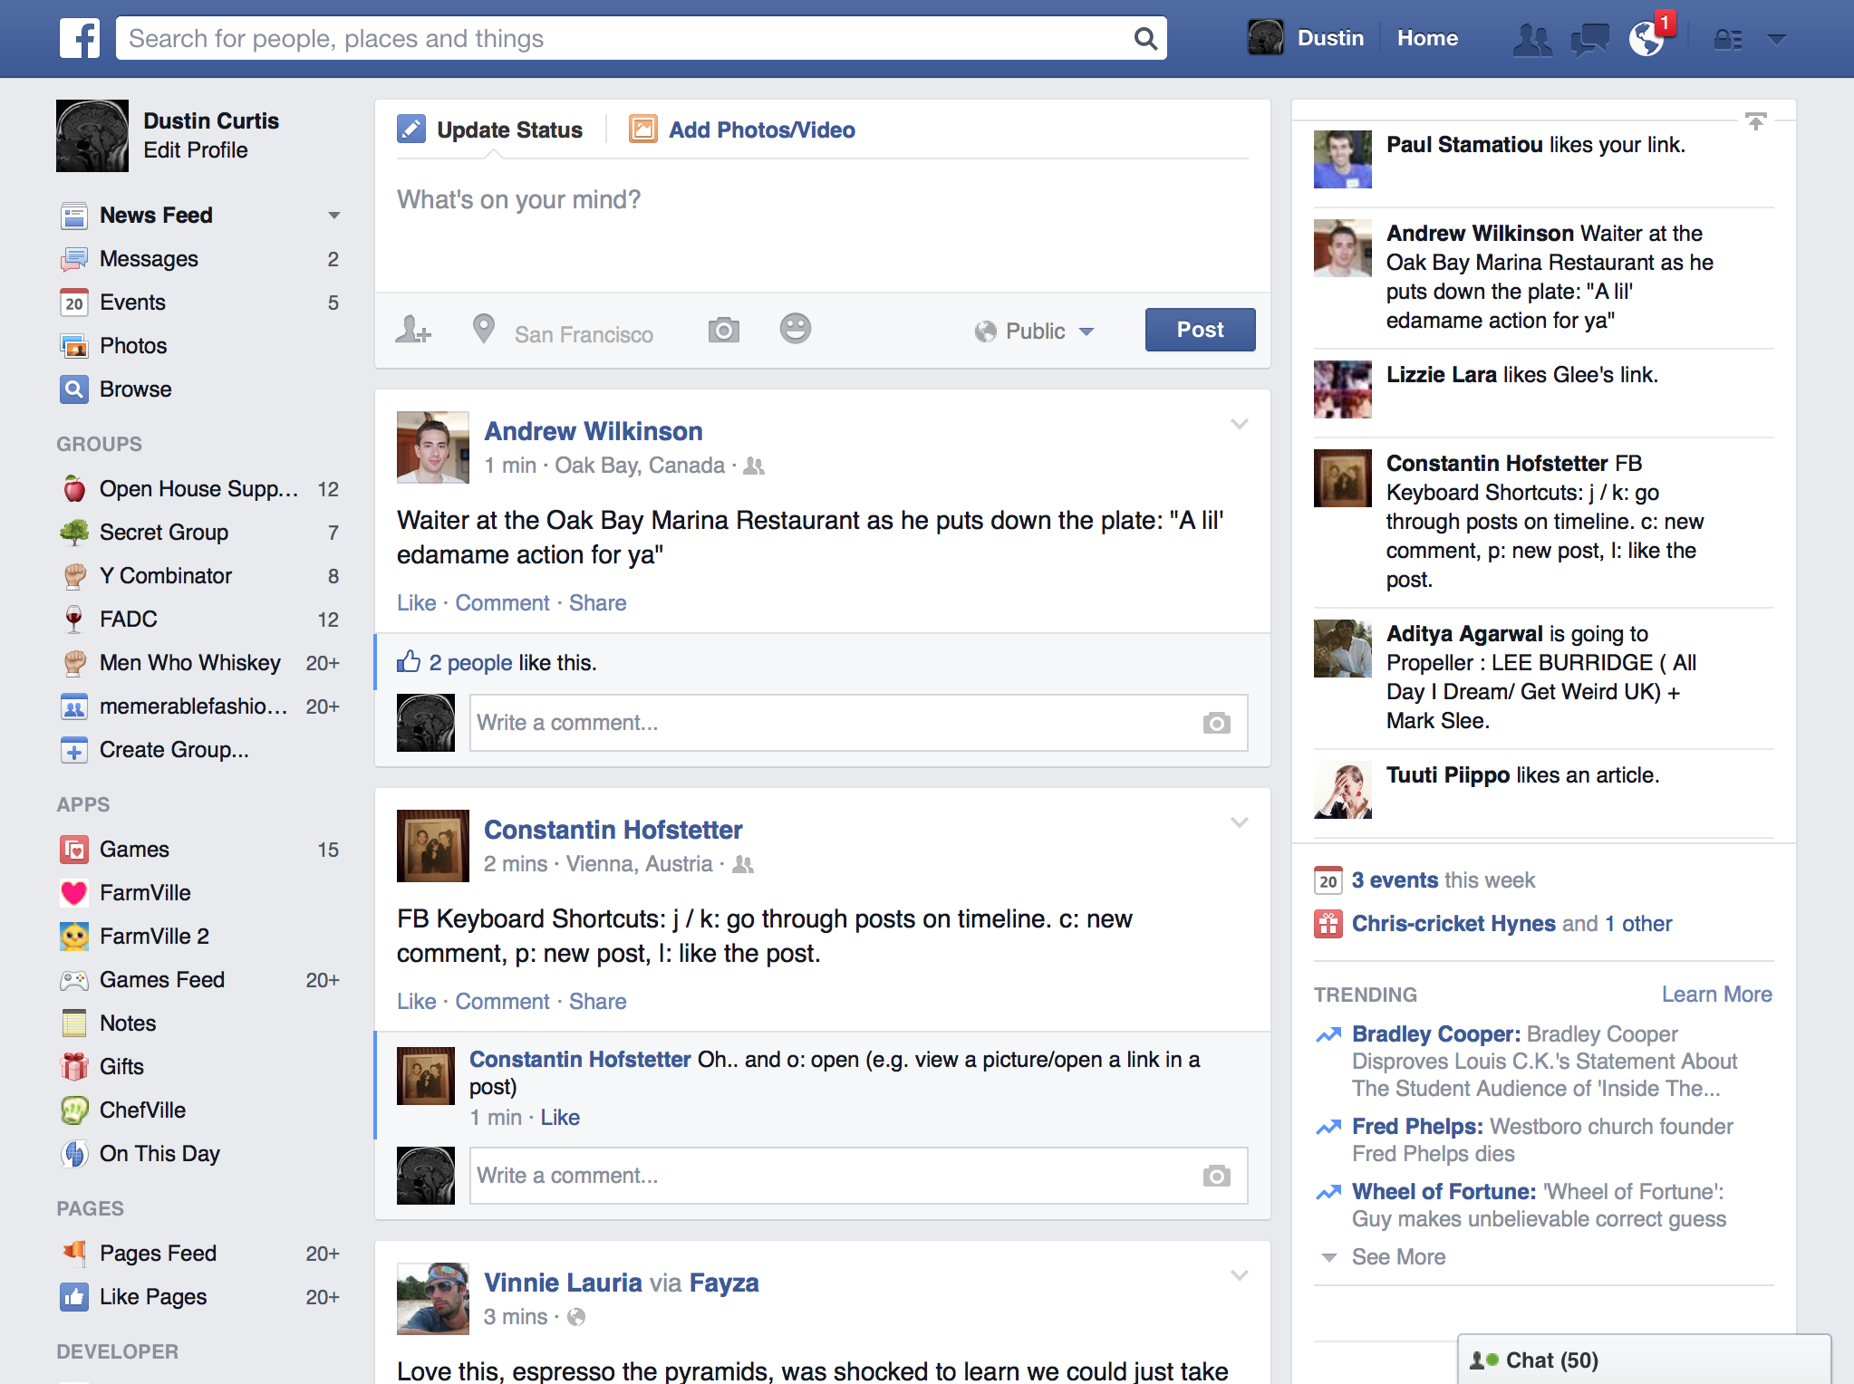
Application Type: Web
More popular. Banking apps, Facebook, email
Notes:
Src: http://img.svbtle.com/pugis6oroxzxcg.png

Slide 6
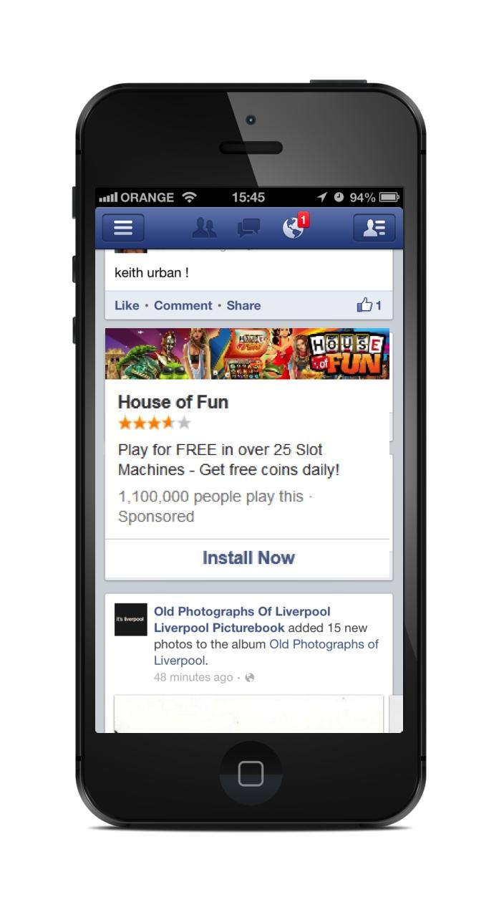
Application Type: Mobile
More mobiles in our hands today
More mobile apps are developed
Notes:
Src: http://www.adweek.com/socialtimes/files/2013/01/BidalgoiPhoneAd.jpg

Slide 7
Programming Mentality
Language syntax is not your main concern...but the programming mentality
That is...your ability to think in program flow regardless the language syntax
E.g. If you know how to think recursively, you can code it any language...or top down thinking vs bottom up
Language syntax is just a mean to express

Slide 8
Programming Concepts
There are many different programming languages
They share much of the programming concepts
Each language has some specific features
C++ return only one parameter or void
Python returns multiple values
Garbage collector in Java but not C++
One language may fit in a situation more than another one

Slide 9
Programming Languages
Some languages are general purpose (e.g. C++ / Java / C# / Python)
Some languages although can be used as general purpose, but it works well only when used in its specific purpose (e.g. PhP for web)
Some languages are for specific purpose (e.g. R language for statistical computing/graphics)
Some languages are compiled (C++/Java/C#) and others interpreted (Python)

Slide 10
Programming Languages
There are debates about which languages to learn first (e.g. C++/Java/C#/Python)?
Every side has strong reasons .. so start with any :)
You must learn more than a language before graduation to know different concepts
If you managed the first language, learning others is matter of 1-3 weeks.
In languages we must read in books. In your major language, read in different levels.

Slide 11
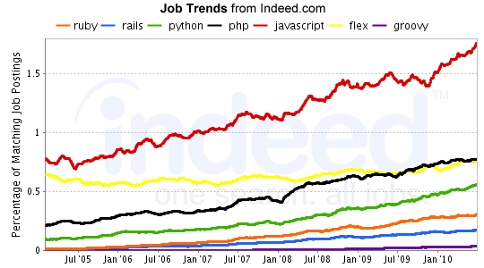
Programming Trends
There many languages..languages usages go up and down.
Read about the recent programming trends
Given Trends are not so accurate..so just read to know top 5-10 active languages
Read in languages comparisons
Productivity? Performance?
Portability?
C vs C++? J2ee vs .Net?
Java vs Python?...etc
Notes:
Src: http://regulargeek.com/wordpress/wp-content/uploads/2011/02/indeedWebJobTrendsAug20103.png

Slide 12
C++
C++ has some special features (good for CS education) such as (Pointers, memory management, SSE instructions..)
C++ has major advantages that will make it part of the future...the performance
C/C++ can beat many other languages in performance...But such performance point is not critical for every application...or critical for every code block
That is why C++ has small market share

Slide 13
Java and .Net Tracks
Java (J2SE and J2EE) and .Net are 2 big stack of technologies
Many frameworks/libraries available to support you in web, mobile, front end, back end….not just language to learn
Abstraction, Security, Support.... are in mind
You can develop any app with them…
They eat much of the software market share...but this changes from time to time

Slide 14
Programming Languages Mix
In many companies, they would pick a general purpose language (specially Java or .Net) and develop whole application using it
But, Languages can communicate together
In Other companies, they mix the language and use each language where it is so powerful
E.g. C++ for performance operations (e.g. matrices)
E.g. Use Java for networking
E.g. Use Python in the overall code for less coding lines

Slide 15
Programming Languages: Plan
Learn C++ (first 2 years)
Read “A first book of C++” from cover to cover or any
Solve many exercises...Do many projects
Optional: Share in Programming Competitions
Pick Major Track (Java or .Net (C#) stack)
Learn it in the last 3 weeks of 2nd year vacation
Keep learning in this stack for following years
Before 3rd year vacation learn web basics
(HTML, Javascript, CSS) + JSP/ASP or PhP or Ruby on rails
Learn Python in 4th year

Slide 16
Internship and Market
Highly utilize your vacations. See my 2 slides for variety of advises.
Go to internship in 3rd year not earlier.
Try to get internship in top companies (e.g. Facebook, Google). See.
DON’T WORK before graduation. Use ALL this time to learn and Practice.
Start early to think about your graduation project.

Slide 17
Knowledge Vs Skills
Learn Something...is easy / short time
Being skilled...is hard & needs much practice
Learning Programming Basics
VS programing mentality (e.g. from much coding)
Learning OOP
VS OOP design skills (e.g. from projects OOP design)
Learning Algorithms
VS problem solving skills (e.g. from competitions)
Advice: Learn little and Practice Much first and so on = strong knowledge / experience

Slide 18
Googling Skills
The developers search in google heavily
We face many problems..compile/run time
We may wonder what are people's thoughts about something (Can shared pointer cause memory leak? - Is exception handling good?)
And there many answers on web!
Learn Google Search tricks
Google: map<string, vector<int>> filetype:cpp
Find every cpp file with this line :)

Slide 19
Your CV
All the time think about your future CV
Showing Diversity of programming languages
Showing Diversity of projects
Share in Programming Competitions
Share in Google Summer of code
Learn/Share in Open Source Projects
You will see great codes, designs and learn much
Do good internship...Do many projects
Select your 4th year GP project carefully

Slide 20

Notes:
Src http://www.dinkuminteractive.com/wp-content/uploads/2011/11/Thank-You.jpg

Slide 21
تم بحمد الله
علمكم الله ما ينفعكم
ونفعكم بما تعلمتم
وزادكم علماً

